Slide 1

CIS 11051- PRACTICAL FOR DATABASE DESIGN
MYSQL

Slide 2

INTRODUCTION
A Database Management System (DBMS) is a software package designed to define, manipulate, retrieve and manage data in a database. A DBMS makes it possible for end users to create, read, update and delete data in a database.

Slide 3
TYPES OF DBMS
Flat file based DBMS
Hierarchical DBMS
Object Oriented DBMS
Network DBMS
Relational DBMS

Slide 4






SOME WELL KNOWN DBMS
Microsoft SQL Server
Oracle
Microsoft Access
MySQL
Cassandra
Mongodb

Slide 5
TERMINOLOGY
Table:
A table is a matrix with data. A table in a database looks like a simple spread sheet.
Column:
One column contains data of one and the same kind, for example the column postcode
Row:
A row / tuple/ record is a group of related data

Slide 6
SOME BASIC COMMANDS
It is possible to store all the commands and script written into the MySQL prompt using
mysql > TEE E:\Commands.txt
To find out the databases currently existing on the server.
mysql > SHOW DATABASES;
Creating a database
mysql > CREATE DATABASE (Database Name);
Using a database
mysql > USE Database Name;

Slide 7
CONT…..
To exit the MySQL shell
mysql > exit;
mysql > quit;

Slide 8
DATA TYPES
MySQL supports a number of data types in several categories:
Numeric type, Date and time, and String (Text) type.
Date and Time :
DATE | YYYY-MM-DD
DATETIME | YYYY-MM-DD HH:MM:SS
TIMESTAMP | YYYYMMDDHHMMSS
TIME | HH:MM:SS

Slide 9
CONT…
Text Type :
CHAR ( ) | A fixed section from 0 to 255 characters long
VARCHAR ( ) | A variable section from 0 to 255 characters
TINYTEXT | A string with a maximum length of 255 characters
TEXT | A string with a maximum length of 65535 characters
LONGTEXT | A string with a maximum length of 4294967295 characters

Slide 10
CONT…
Number type :
INT ( ) | -2147483648 to 2147483647 normal 0 to 4294967295 UNSIGNED.
FLOAT ( ) | A small number with a floating decimal point.
DOUBLE ( ) | A large number with a floating decimal point.
DECIMAL ( ) | A DOUBLE stored as a string , allowing for a fixed decimal point.

Slide 11
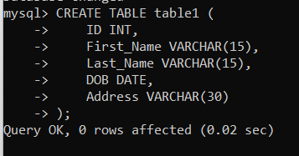
CREATING A TABLE
The CREATE TABLE statement is used to create a table in MySQL.
Syntax
CREATE TABLE table_name ( Column_name1 data_type, Column_name2 data_type, Column_name3 data_type
) ;

Slide 12
VIEW TABLES
You can view all database tables:
mysql > SHOW TABLES;
An empty set indicates that have not created any tables yet.
DESCRIBING TABLE
To view a table structure, use the DESCRIBE command mysql > DESCRIBE table name;
OR
mysql > DESC table name;

Slide 13

INSERTING DATA INTO TABLE…
Used to add new records to a database table
Syntax
Insert 1 record
INSERT INTO table name ( column1, column2 , column3……………..)
VALUES (value1, value2, value3……………………) ;

Slide 14
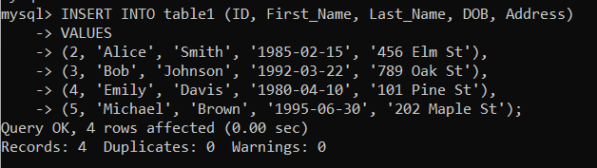
Insert multiple records
Syntax
INSERT INTO table name ( column1, column2 , column3……………..)
VALUES
(value1, value2, value3……………………),
(value1, value2, value3……………………),
(value1, value2, value3……………………);

Slide 15
THANK YOU !

